Slide 1



Statistical Analysis and Learning (SAL): (ISL Linear Model Selection & Regularization, Ch6, part 1) Textbook: An Introduction to Statistical Learning (ISL)
Varun Rai
LBJ School of Public Affairs
The University of Texas at Austin
21st March 2018

Slide 2
Note on Material
Unless otherwise noted, all material in this presentation are from this course’s textbook, An Introduction to Statistical Learning (ISL)

Slide 3
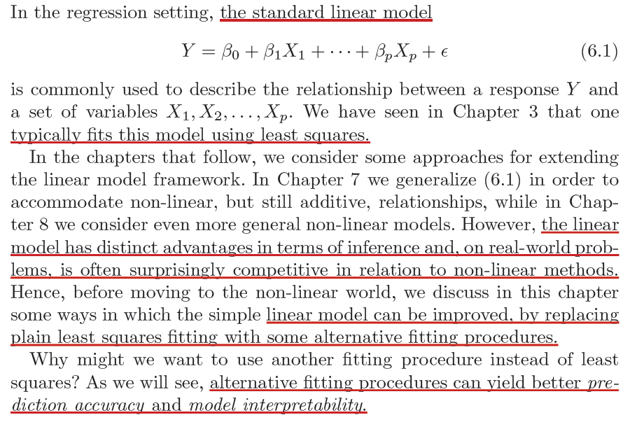
Improving the Linear Model: Alternative Fitting Procedures

Slide 4
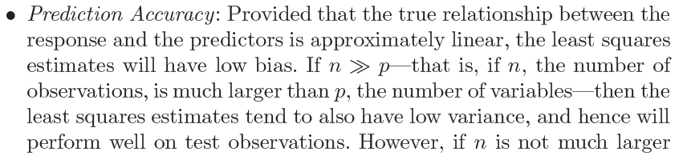
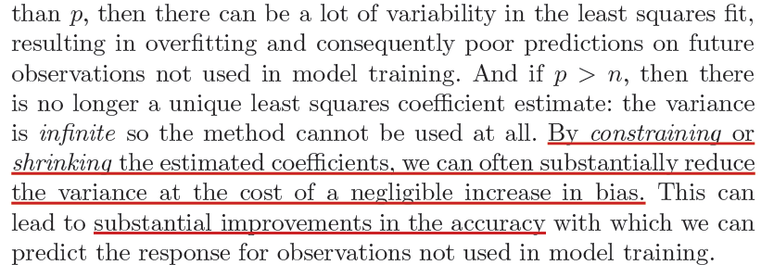
Prediction Accuracy

Slide 5
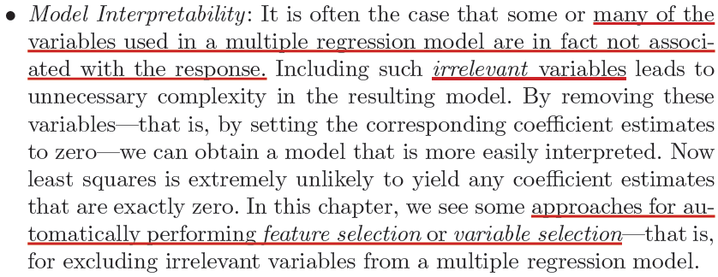
Model Interpretability

Slide 6
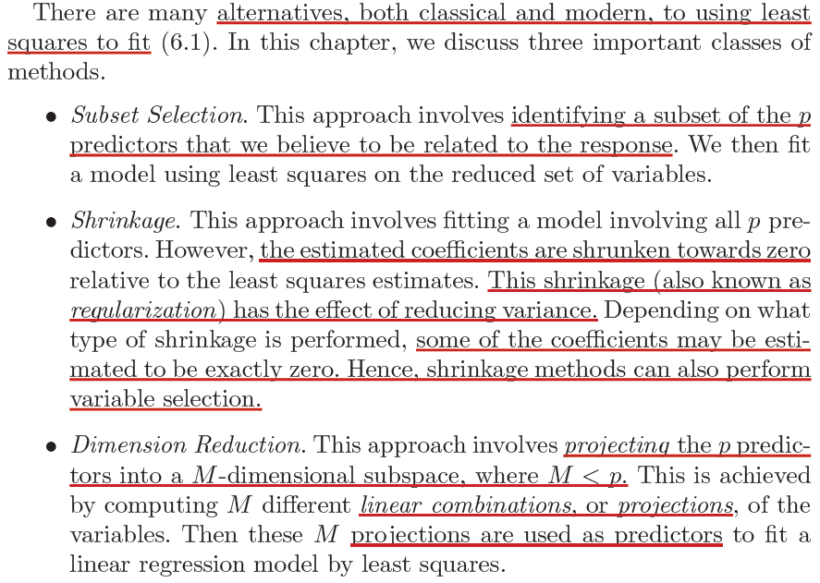
Alternatives to Least Squares Fit

Slide 7
Best Subset Selection

Slide 8
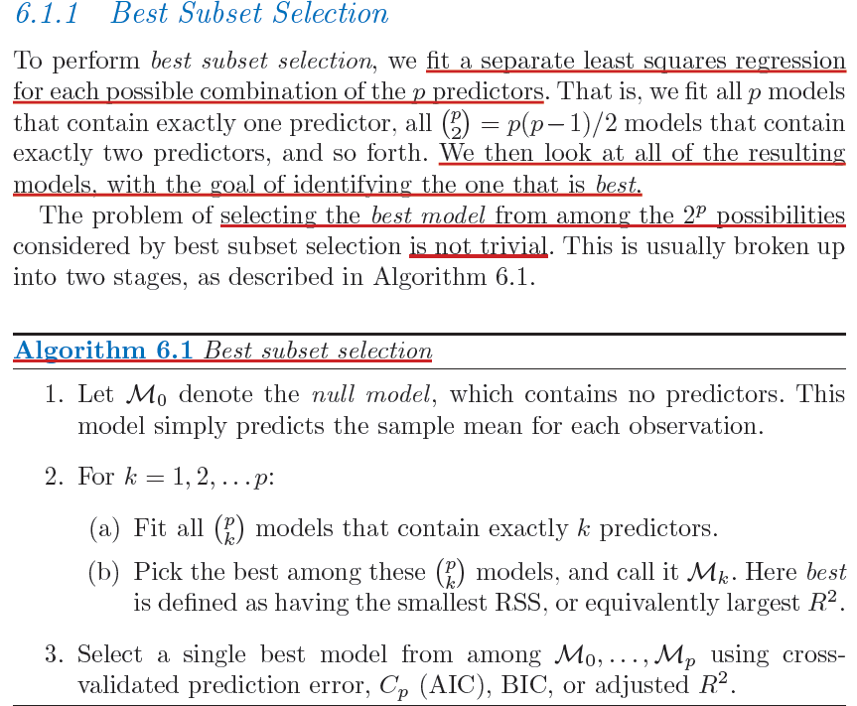

Slide 10
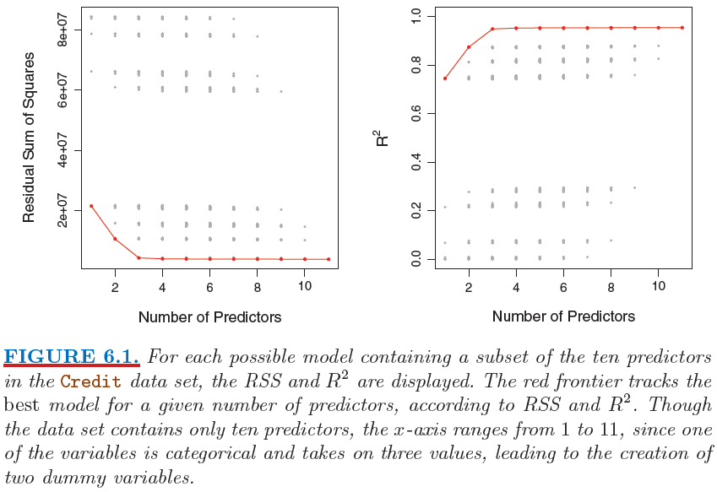

Slide 11
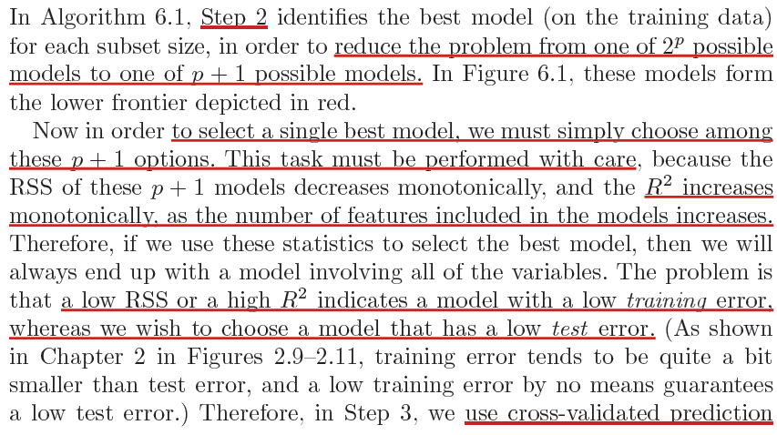
Best Model Selection

Slide 12
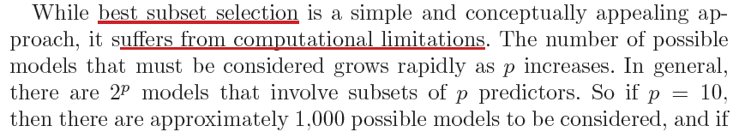
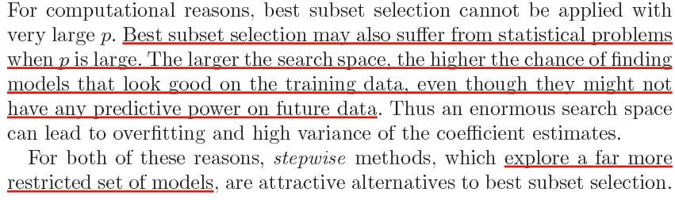
Best Model Selection: Main Disadvantages

Slide 13
Stepwise Selection

Slide 14


Slide 16
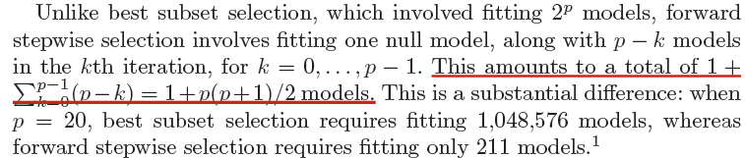
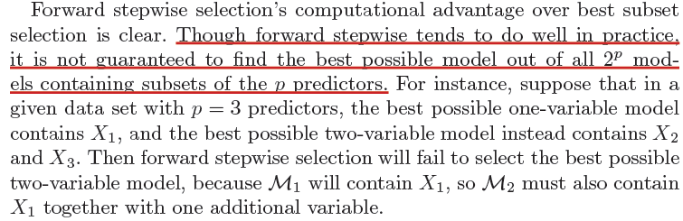
Forward Stepwise Selection: Pros & Cons

Slide 17
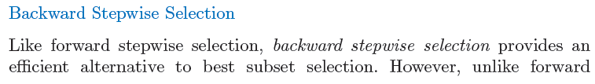
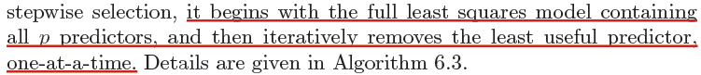

Slide 18
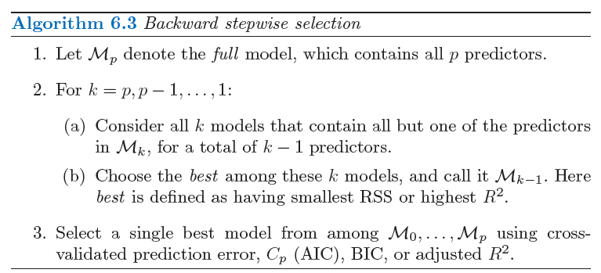

Slide 19
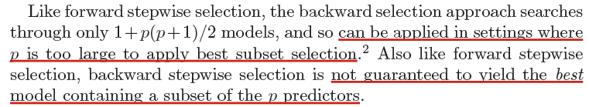
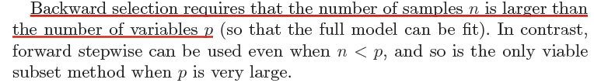
Backward Stepwise Selection: Pros & Cons

Slide 20
Choosing the Optimal Model

Slide 21
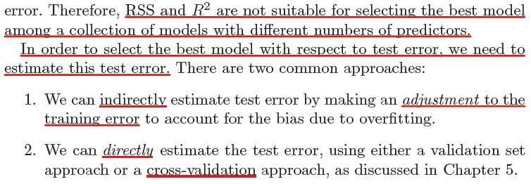
Choosing the Optimal Model: Focus on Test Error

Slide 22
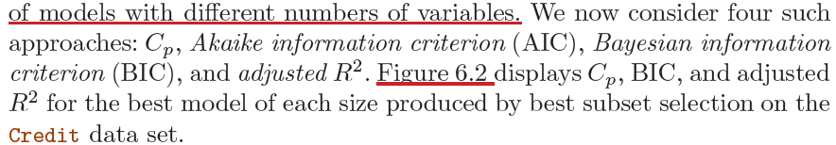

Slide 23
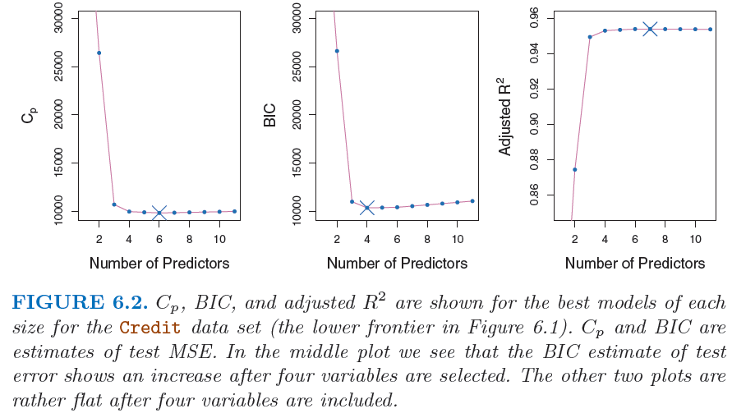

Slide 24
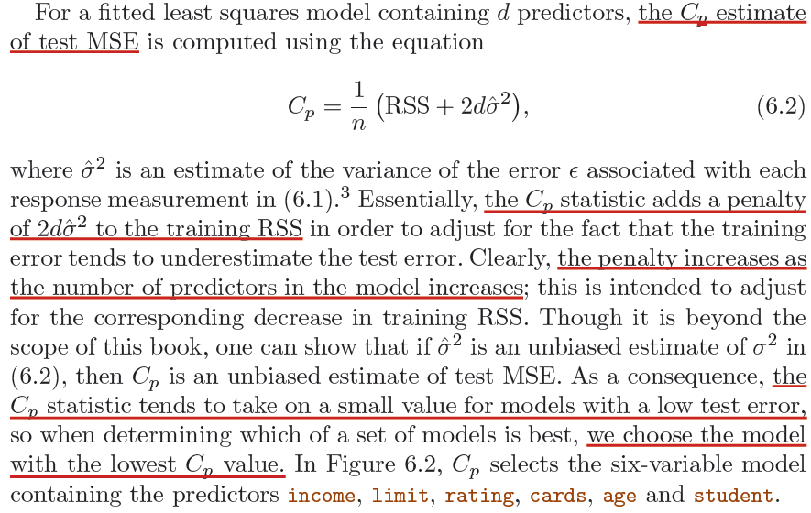
C_{p}

Slide 25
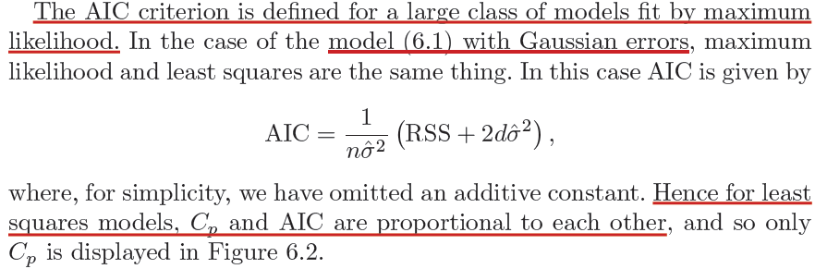
AIC

Slide 26
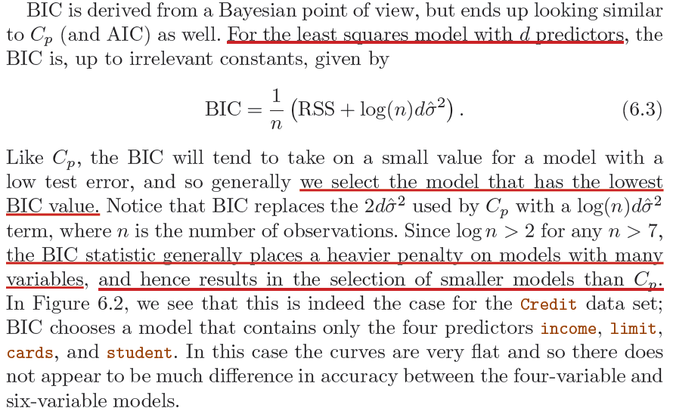
BIC

Slide 27
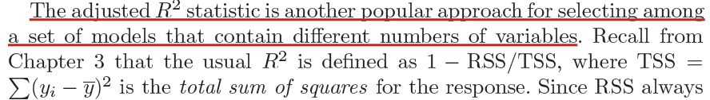
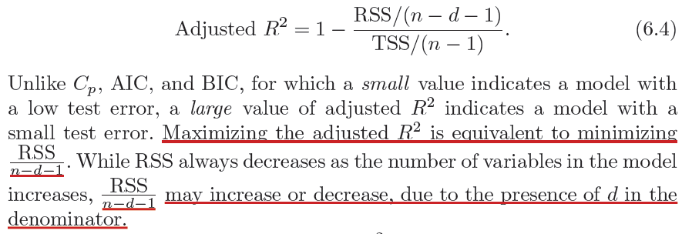
Adjusted R²

Slide 28
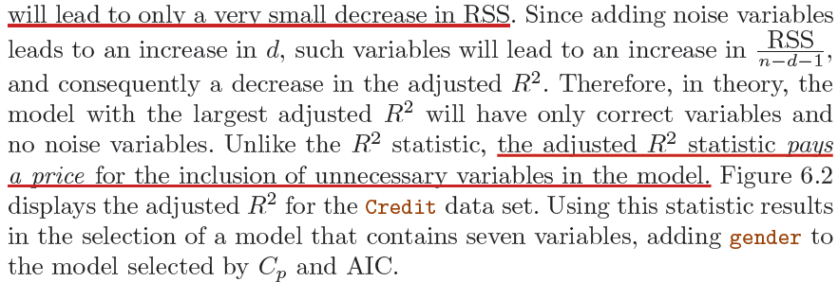
Adjusted R²

Slide 29
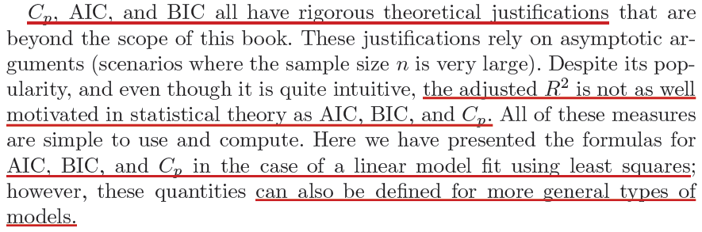

Slide 30
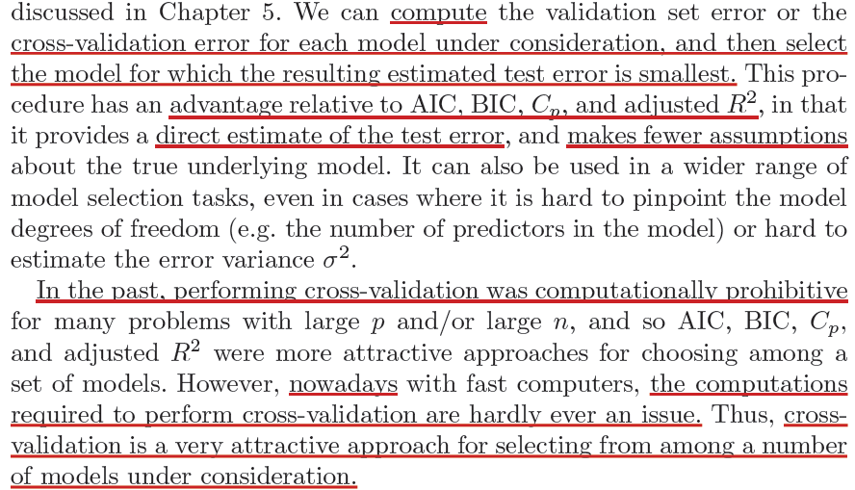
Cross-Validation for Best Model Selection

Slide 31
Cross-Validation for Best Model Selection

Slide 32
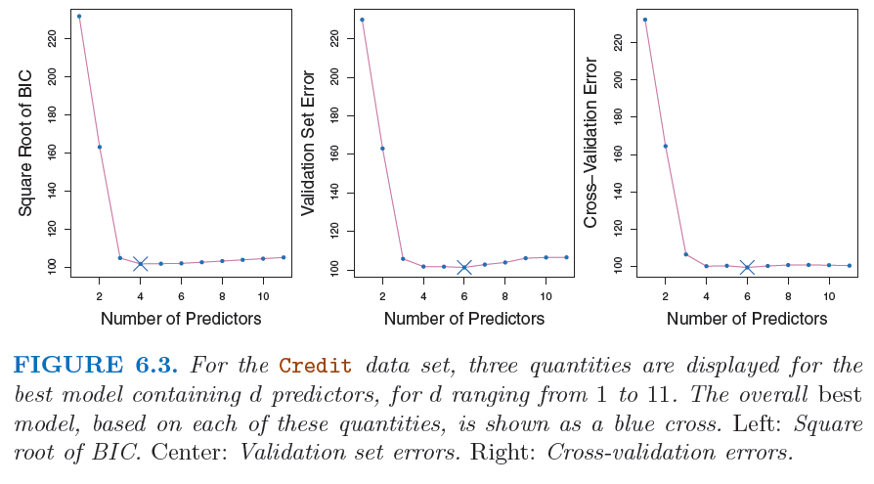
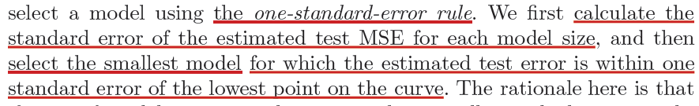
Cross-Validation for Best Model Selection

Slide 33
Shrinkage Methods

Slide 34
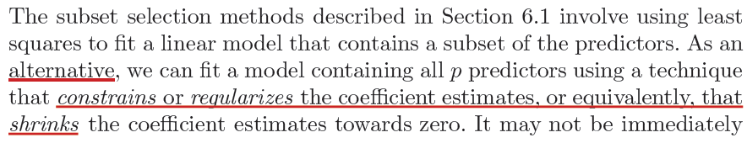
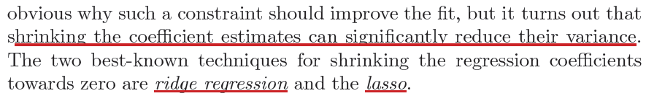
Shrinkage Methods

Slide 35
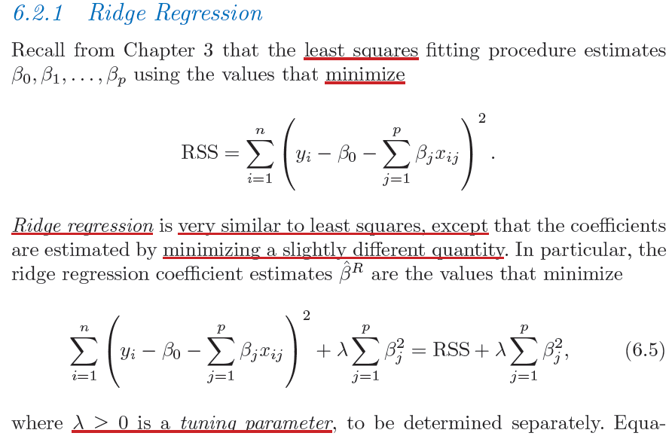
Ridge Regression

Slide 36
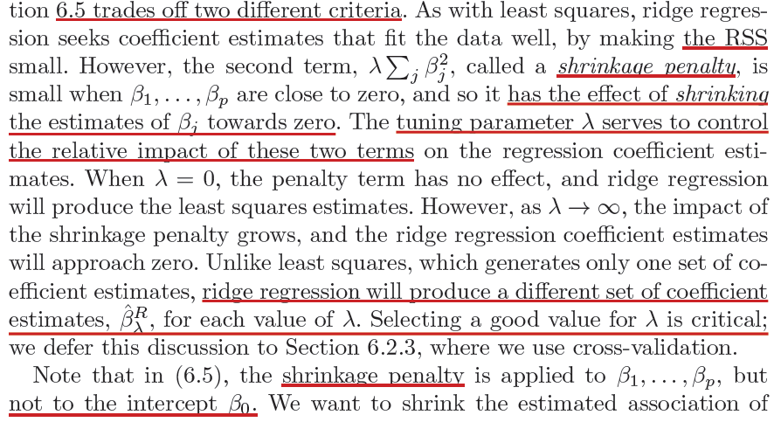
Ridge Regression

Slide 37
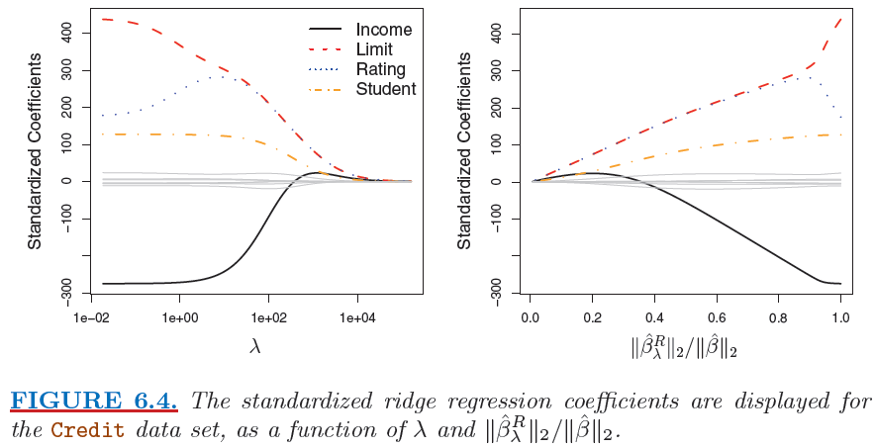
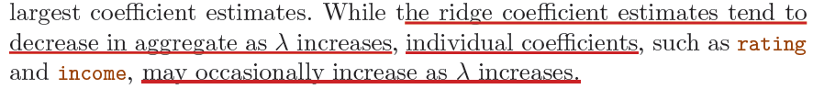
Ridge Regression

Slide 38
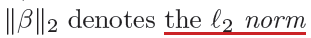
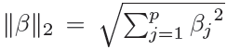
Ridge Regression

Slide 39
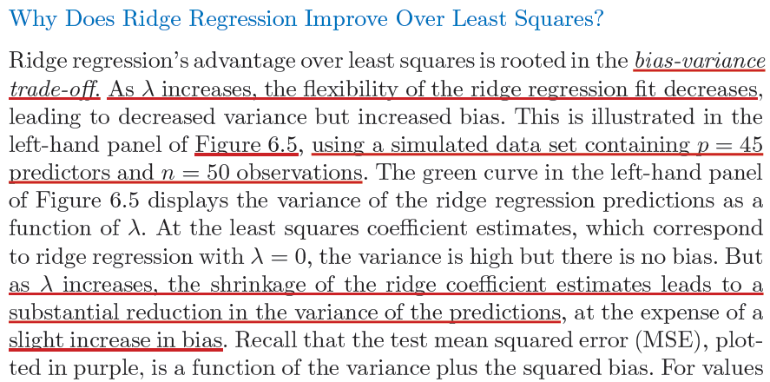
Ridge Regression

Slide 40
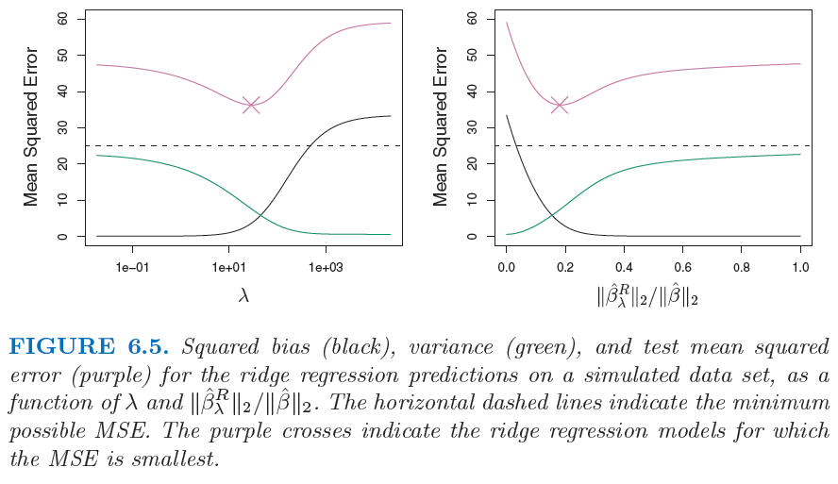
Why Does Ridge Regression Improve Over LS?
V
B^2

Slide 41
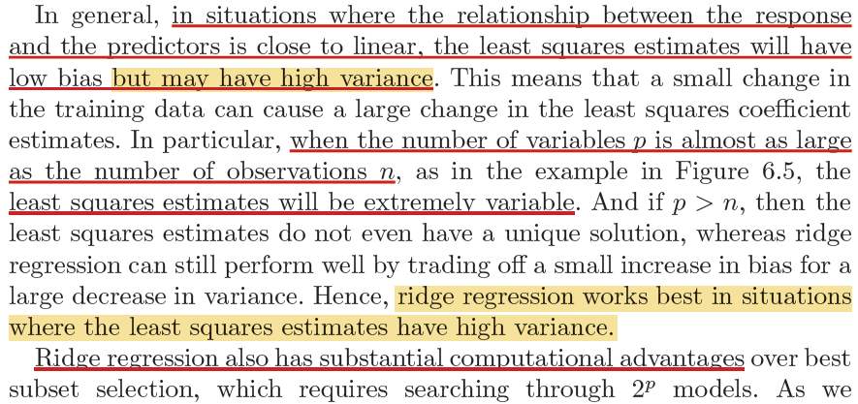
Why Does Ridge Regression Improve Over LS?

Slide 42
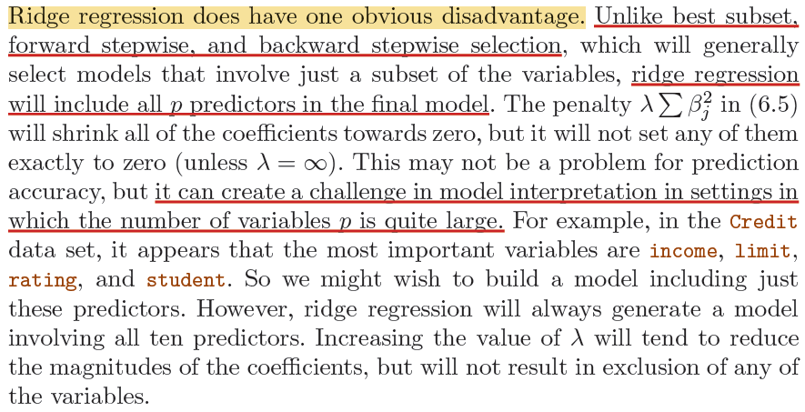
Ridge Regression: A Disadvantage

Slide 43
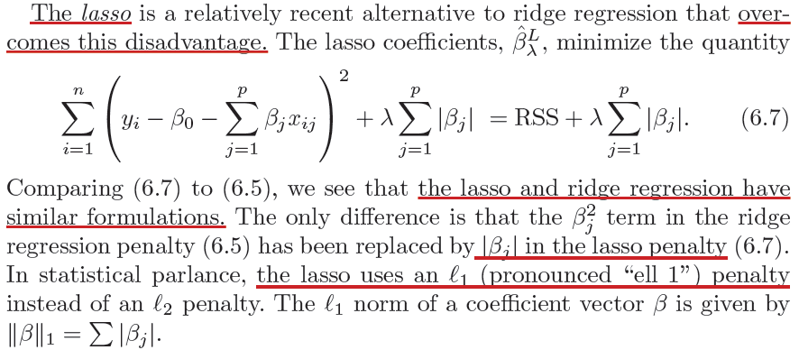
The Lasso

Slide 44
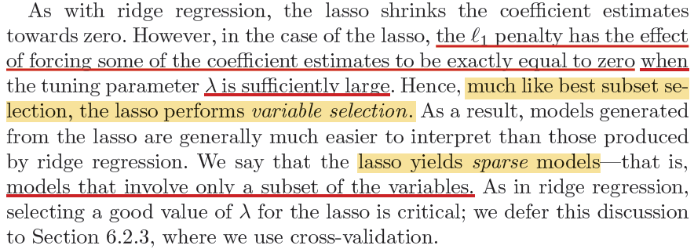
The Lasso

Slide 45
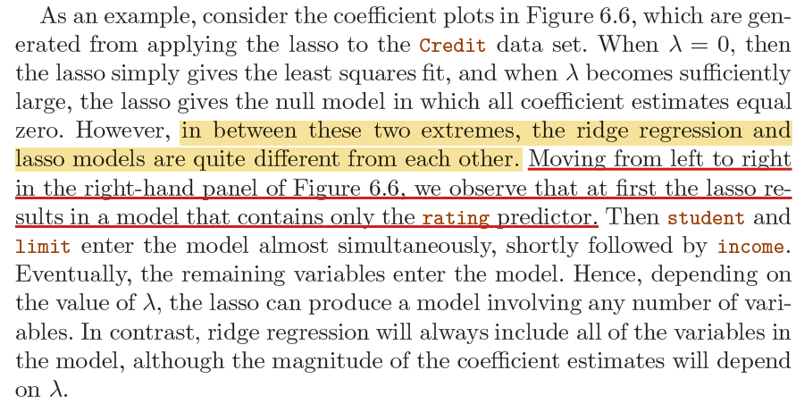
The Lasso

Slide 46
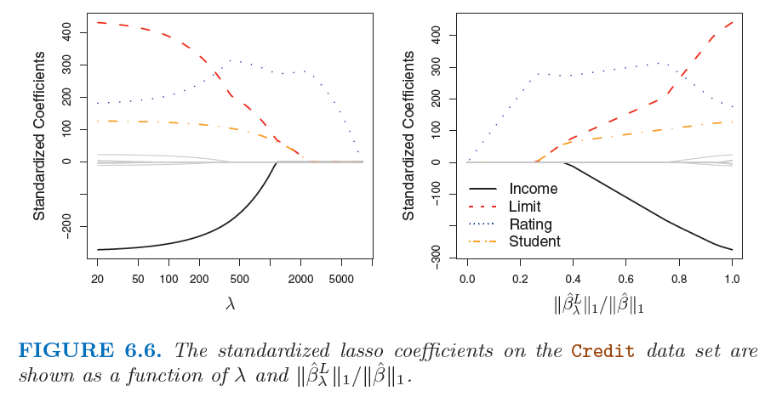
The Lasso

Slide 47
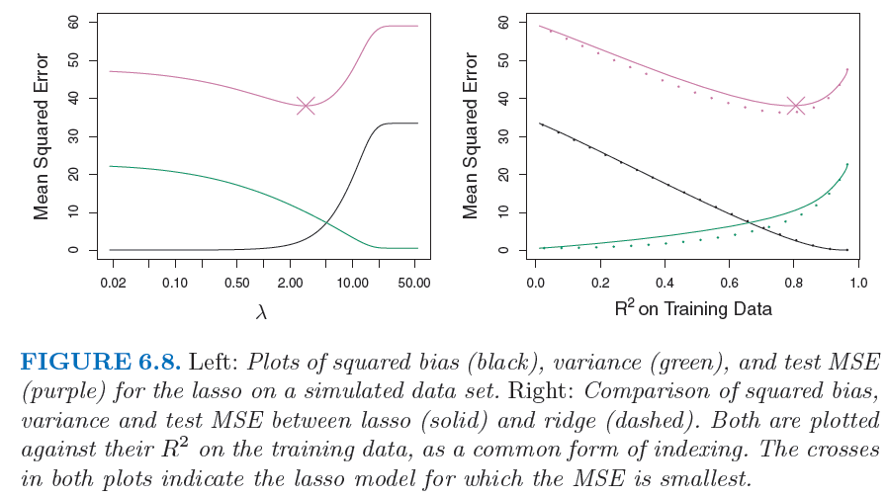
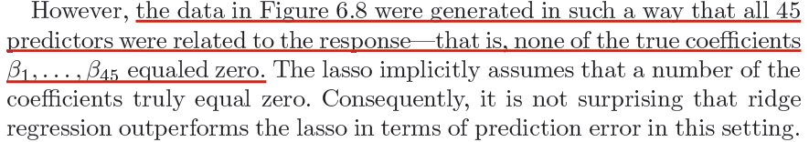
Comparing the Lasso and Ridge Regression

Slide 48
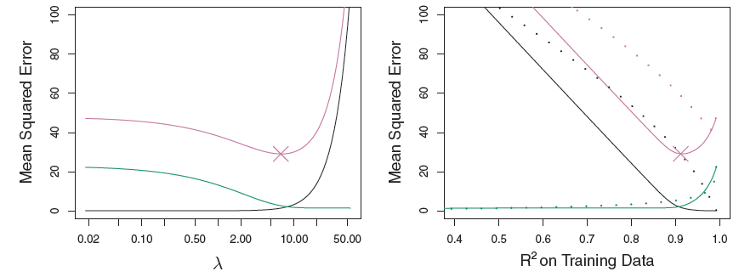
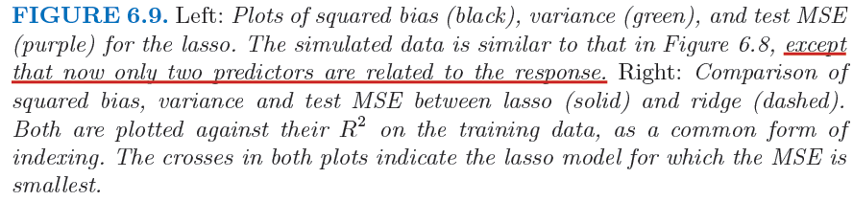
Comparing the Lasso and Ridge Regression

Slide 49

Comparing the Lasso and Ridge Regression

Slide 50

Selecting the Tuning Parameter

Slide 51


Selecting the Tuning Parameter

Slide 52


Selecting the Tuning Parameter

Slide 53

End of Lecture #8
Source: http://yaroslavvb.blogspot.com/

